Slide 1


Bse3214: Cloud Computing and Big Data
Understanding data management in the digital age
Moses Ntanda, PhD
Lecturer | networks department | school of Computing & IT | Makerere University Kampala
Notes:
- Applied Human Machine Intelligence

Slide 2
Contacts (In order of preference)
Dr. Ntanda Moses
Email: moses.ntanda@mak.ac.ug
Office: Block A, Level 3, Networks Department, Room 304
Mobile: 0752533355
Notes:
contacts

Slide 3
Overview and Description
Course Objectives
Provide students with the comprehensive and in-depth knowledge of Cloud Computing concepts, technologies, architecture and applications
Introduce research on state-of-the-art in Cloud Computing fundamental issues, technologies, applications and implementations.
Expose students to big data that comes along with cloud computing and ways to store, manage & analyse big datasets for decision-making.

Slide 4
Learning Outcomes
Upon completion of the course, you should be able to:
Understand Cloud Computing Fundamentals: Articulate the core concepts, technologies, benefits, limitations, and applications of cloud computing.
Explore Cloud Architectures: Identify various cloud models and services, including SaaS, PaaS, IaaS, and deployment types like public, private, and hybrid clouds.
Evaluate Deployment Options: Analyze the trade-offs between using cloud infrastructure and local systems.
Compare Cloud Platforms: Assess the pros and cons of different cloud computing platforms.

Slide 5
Learning Outcomes
Analyze Cloud Performance: Evaluate the performance, scalability, and availability of cloud technologies and software.
Conduct Economic Analysis: Perform cost-benefit analysis of cloud business models.
Address Cloud Challenges: Explain key issues such as security, privacy, and interoperability in cloud environments.
Work with Big Data: Demonstrate skills in storing, managing, and analyzing unstructured data and processing big data.
Assess Societal Impact: Analyze how big data analytics influence society.

Slide 6
Mode of Delivery
Lectures, Practical, & Tutorials

Slide 7
indicative Content
See course webpage on MUELE

Slide 8
Assessment
Coursework and short projects
Presentations
Assignments
Final exam (70%)

Slide 9
Reading Materials
Cloud Computing: Concepts, Technology & Architecture 2013, By Richardo Puttini, Thomas Erl, and Zaigham Mahmood, 2013
Ray Rafaels, 2018, Cloud Computing, 2nd Ed., CreateSpace Independent Publishing Platform, ISBN-10 : 1986726282
Kevin L. Jackson and Scott Goessling , 2018, “Architecting Cloud Computing Solutions: Build cloud strategies that align technology and economics while effectively managing risk” Packt Publishing, ISBN-13 : 978-1788472425
IoT Fundamentals: Networking Technologies, Protocols, and Use Cases for the Internet of Things: 2017, by David Hanes
Other Materials: Several modules will be based on recent conference/journal papers as well as documentation from cloud providers

Slide 10
In This Lecture
Overview of cloud computing: History, and Characteristics
Service & Deployment models (IaaS, PaaS, SaaS), Infrastructure, and Consumer View
Advantages and challenges of cloud computing

Slide 11
Overview of cloud computing
What is cloud computing?
Types of cloud computing
Service Deployment Models
Overview

Slide 12
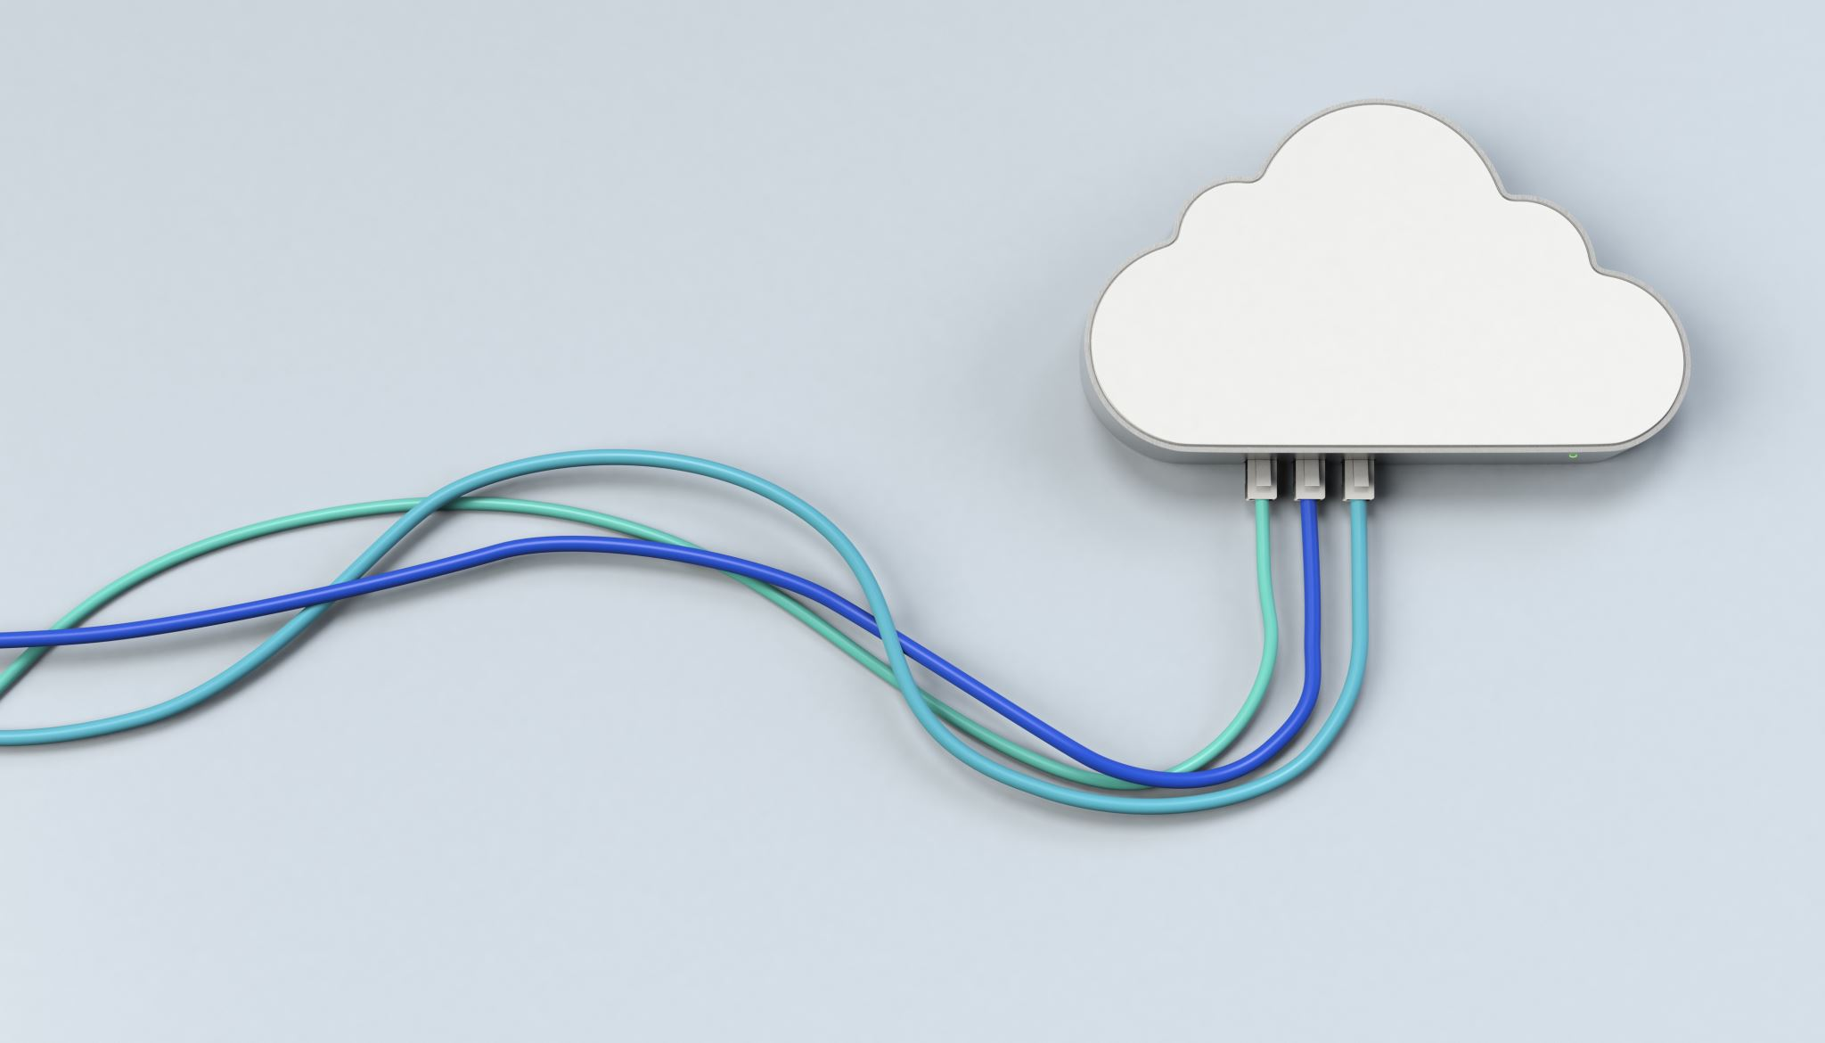
What is cloud computing
Cloud computing is the delivery of computing services via the internet, enabling flexible resource access.
Users can access technology resources on-demand, eliminating the need for physical hardware management.
Cloud computing includes various services such as storage, processing power, and software applications.
Notes:
Cloud computing is a model of delivering computing services over the internet, where resources such as servers, storage, databases, software, and applications are provided as a service to users on-demand

Slide 13
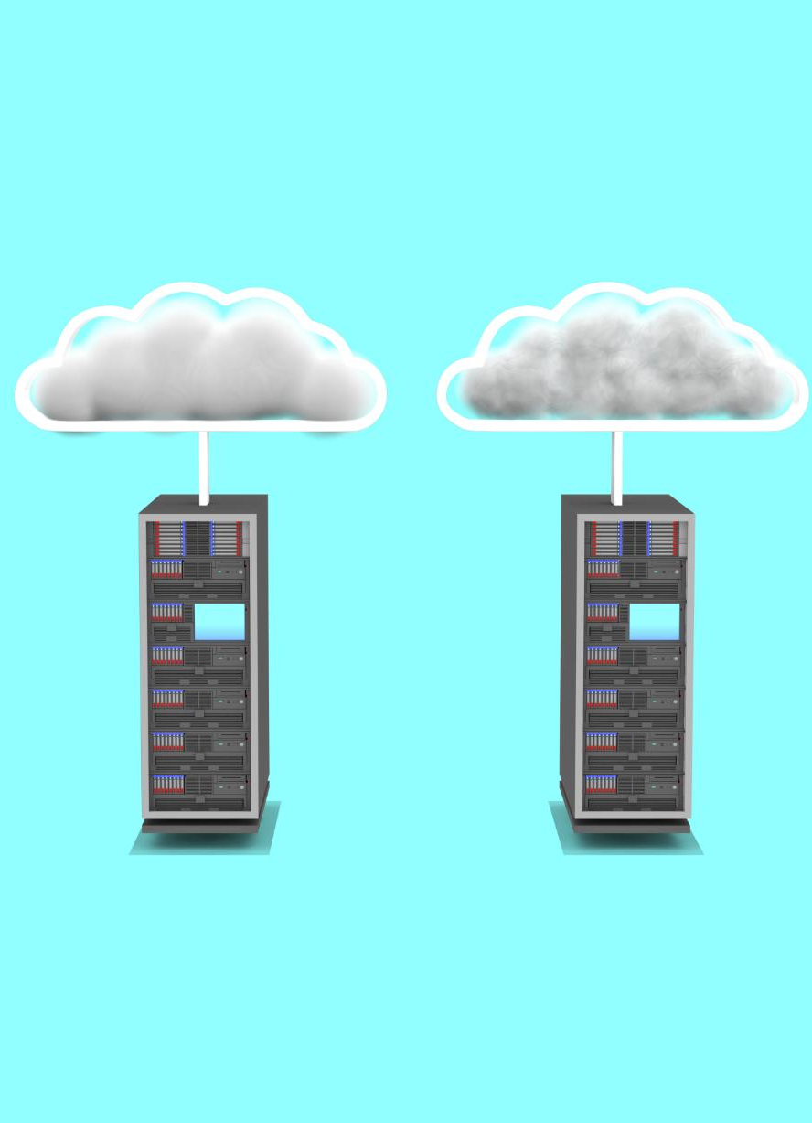
Historical Evolution of Cloud Computing
Early Mainframe Computing
The journey began with mainframe computing in the 1960s, laying the groundwork for future innovations.
Concept of Virtualization
In the 1960s, the concept of virtualization emerged, allowing multiple workloads on a single system, paving the way for cloud technology.
Modern Cloud Implementations
The early 2000s marked the beginning of modern cloud computing, enabling diverse services like IaaS, PaaS, and SaaS.
Notes:
Cloud computing has evolved from early mainframe computing and the concept of virtualization in the 1960s through to modern implementations that began in the early 2000s, leading to today's diverse offerings.
Mainframe computing refers to a class of high-performance, multi-user computers that have been in use for several decades. These systems are typically large-scale, complex machines that serve as the backbone of many organizations' IT infrastructure.
Virtualization and mainframe computing are two distinct approaches to managing computer systems and resources. Virtualization provides a flexible and efficient way to manage multiple virtual machines on a single physical host, while mainframe computing provides high-performance capabilities and robust security features for critical business applications.

Slide 14
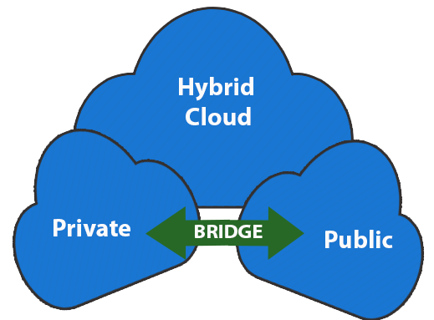
Types of cloud computing
Public Cloud: Services are offered over the public internet and are available to anyone who wants to use them.
Examples: AWS (Amazon Web Services), Microsoft Azure, Google Cloud Platform.
Private Cloud: Cloud infrastructure is used exclusively by a single organization, providing more control and customization
Examples: Mak Webmail, ACMIS, Several Banks etc
Hybrid Cloud: Combination of public and private clouds, allowing data and applications to be shared between them.
Notes:
Cloud computing is a model of delivering computing services over the internet, where resources such as servers, storage, databases, software, and applications are provided as a service to users on-demand
Community Cloud
Community clouds are shared among several organizations with similar interests, providing a collaborative environment.

Slide 15
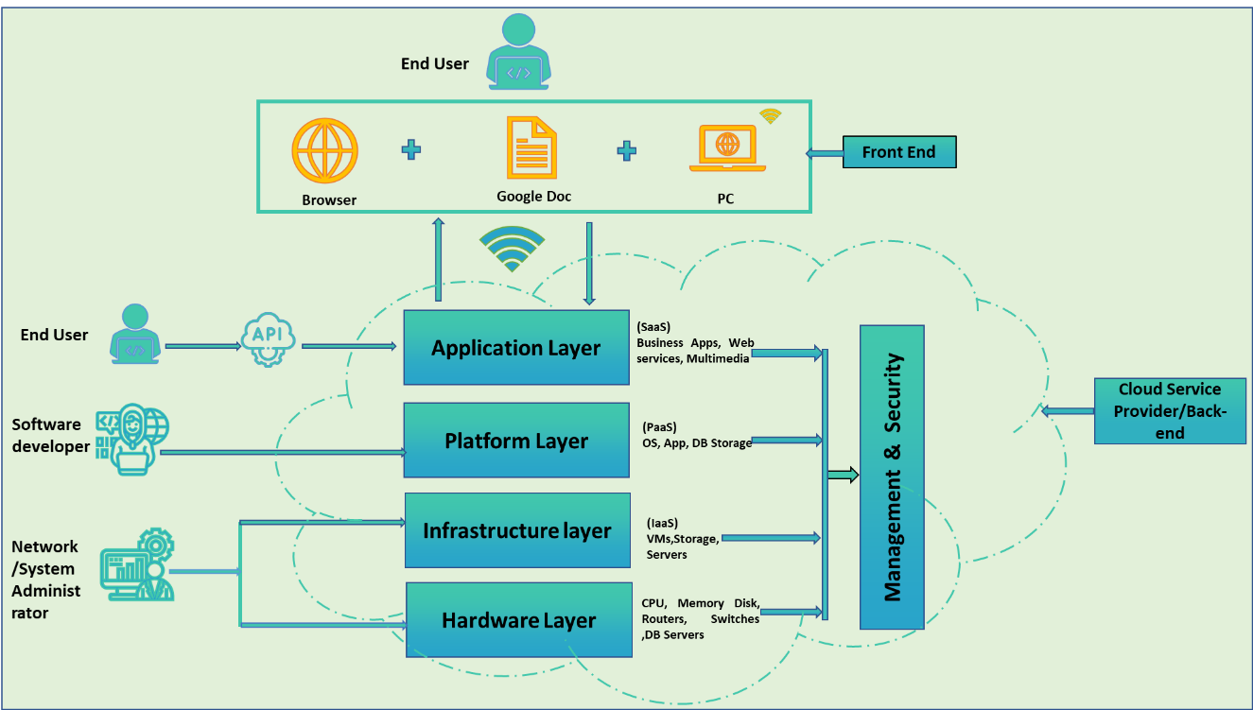
Structural Layers of Cloud Computing
Application Layer: Consists of the actual software applications that end-users interact with.
Platform Layer: Includes the tools, frameworks, and services that developers use to build and deploy applications.
Notes:
Application layer: Consist of different applications related to real cloud e.g. email system, storage management applications, office tools.
Platform: Includes middleware, databases, development frameworks, and other tools that simplify the process of creating and running applications.

Slide 16
Structural Layers of Cloud Computing
Infrastructure Layer: Involves the software and services responsible for managing and orchestrating the hardware resources.
Hardware Layer:
Consists of hardware.
Notes:
Infrastructure: This includes operating systems, virtualization, and containerization technologies.

Slide 17
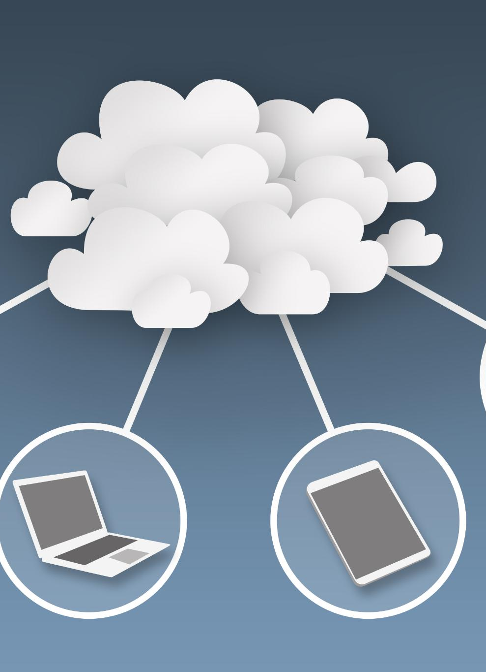
Service and deployment Models
Software as a Service (SaaS): Also known as On-Demand Software. Delivers software applications over the internet, enabling users to access software solutions without installation or maintenance
Platform as a Service (PaaS): Offers a platform allowing developers to build, deploy, and manage applications without worrying about underlying infrastructure
Infrastructure as a Service (IaaS): Provides virtualized computing resources over the internet, allowing users to manage infrastructure without physical hardware. The provider manages the entire infrastructure, including servers, storage, and networking, so you can simply access the software through a web browser or mobile app.
Notes:
These are approaches that represent the way services are provided by every layer from the bottom to the top one.
SaaS: It is a software distribution model in which services are hosted by a cloud service provider. These services are available to end-users over the internet so, the end-users do not need to install any software on their devices to access these services.
IaaS: With IaaS, you can rent these resources from a cloud provider like Amazon Web Services (AWS), Microsoft Azure, or Google Cloud Platform, and pay only for what you use.

Slide 18

CHARACTERISTICS OF CLOUD COMPUTING
Dynamic (Flexible): Dynamically scalable which minimizes the investment risk related to the user.
Virtualization: Cloud computing applications and platforms are created according to resource virtualization concept. Virtualization refers to the practice of creating a virtual platform e.g. as servers, storage, or networks.
On-Demand service: Based on actual user demands.
Dynamic customization: Cloud rental resources are highly customizable, allowing users to tailor services to their specific needs.
High reliability: Cloud computing platforms prioritize the security of customer data and application reliability.
Broad Network Access: Cloud services are accessible over the network, providing users with access through various devices like laptops, smartphones, and tablets.
Notes:
, Cloud resource platforms are meaning that, they are able to be enlarged or reduced in size based on user demand, and can satisfy the demands of many users
Virtualization performs a significant task in developing the effectiveness of resource efficiency and raising the level of service security and reliability.
Economies of scale: Cloud computing is dominated by large companies, such as IBM, Microsoft, Google, and Amazon, which have the ability to employ large-scale resources that enable them to minimize rental and exploitation costs. As a result, cloud computing companies can recruit as many users as possible.
Cloud services are obtained and billed based on actual user demands, eliminating the need for significant one-time investments and enabling users to acquire resources as needed.
Cloud rental resources are highly customizable, allowing users to tailor services to their specific needs, particularly in Infrastructure as a Service (IaaS) where virtual and specialized devices can be deployed.
: Cloud computing platforms prioritize the security of customer data and application reliability. This is achieved through platform backups, multiple data locations, dynamic network management, and the ability to migrate resources dynamically in case of failure or low effectiveness

Slide 19
BENEFITS OF MOVING TO THE CLOUD
Optimum Resource Utilization: Resources are released after every use thus resource utilization.
Rent on Demand: Access to diverse computing and infrastructure resources and services anytime, anywhere. Enables growth and sustainability for businesses of all sizes, fostering innovation and competition.
Minimized IT Staff: Moving to cloud computing results in reduction of inhouse IT staff to maintain the existing systems.
Minimized Infrastructure Relocating resources to the cloud, or accessing platform as a service, means that it is possible to maintain a smaller inhouse hardware infrastructure.
Managed Costs: Cloud service providers operate on economies-of-scale, minimizing costs and offering updated hardware and software applications. Prices and licensing can be reduced as cloud computing services are based on predetermined service models.
Enhanced Vulnerability Control: Constant monitoring of system activities and logs to detect and prevent security threats. Regular updates with state-of-the-art technologies to ensure no vulnerabilities exist in the cloud computing ecosystem.

Slide 20

Key Points
Current Development:
Exponential growth in cloud computing, a major revenue generator.
Adoption of innovative technologies like ML, AI, and blockchain.
Unprecedented spending, indicating sustained industry growth.

Slide 21
Challenges
Reliability & Performance: Lag, outages, and dependence on cloud resources can impact performance. Robust network management and fault tolerance are key.
Resource Provisioning & Scheduling: Efficient algorithms are needed to optimize resource allocation, reduce response times, and manage large demands.
Management Issues: Complexities like resource consolidation, client management, and single-provider limitations require advanced solutions like decentralization and multi-cloud strategies.
Fault Tolerance: Keeping services running despite failures is crucial. Redundancy, disaster recovery plans, and self-healing systems are vital.
Privacy & Transparency: Building trust with user data privacy and service transparency is essential. Strong encryption, clear policies, and regular audits are crucial.
Security: The biggest challenge. Data security, integrity, and confidentiality are at stake. Strong protocols, access control, and continuous monitoring are necessary.
Notes:
Threats:
Data Breaches: The biggest concern, leading to exposure of sensitive information.
Compromised Credentials: Weak passwords, hacking, and insider threats can grant unauthorized access.
DoS Attacks: Overwhelming systems with requests to disrupt service.
Virtualization Exploitation: Shared resources in VMs increase attack possibilities.
Network-based Attacks: Traditional threats like snooping and DNS hijacking persist.
Application-based Attacks: Hacking, dictionary attacks, and vulnerabilities put applications at risk.
Host-level Attacks: Malware, worms, and unauthorized access remain concerns.

Slide 22
Challenges: Attacks
Network: Attacks on communication channels and infrastructure.
Hardware: Exploiting physical resources like memory and caches for sensitive data access.
Hypervisor: Compromising the core software managing VMs to control entire systems.
Network Security:
Antivirus, firewalls, and intrusion detection systems.
Hardware Security:
Cryptography, isolation technologies, and trusted execution environments.
Hypervisor Security: Software and hardware isolation mechanisms, secure boot, and memory encryption.
Notes:
Threats:
Data Breaches: The biggest concern, leading to exposure of sensitive information.
Compromised Credentials: Weak passwords, hacking, and insider threats can grant unauthorized access.
DoS Attacks: Overwhelming systems with requests to disrupt service.
Virtualization Exploitation: Shared resources in VMs increase attack possibilities.
Network-based Attacks: Traditional threats like snooping and DNS hijacking persist.
Application-based Attacks: Hacking, dictionary attacks, and vulnerabilities put applications at risk.
Host-level Attacks: Malware, worms, and unauthorized access remain concerns.

Slide 23
Key Points
Challenges:
Reliability issues and system performance challenges.
Privacy and security concerns posing obstacles.
Complexities in resource provisioning and scheduling.
Management issues in handling dynamic cloud platforms.
Addressing fault tolerance and ensuring data integrity.
Ongoing concerns about transparency and privacy.

Slide 24
Future trends
Intelligent Machine Learning (ML) Techniques
Automation and Optimization with ML
Key Points:
ML algorithms for automation and optimization in cloud computing.
Example: Intelligent threat detection and classification improving security.
Automation of resource allocation and decision-making processes.
Notes:
Future Trends:
Intelligent Machine Learning Techniques:
Automation, optimization, and advanced threat detection.
Adoption of AI and Blockchain Technologies:
Transformative impact on security, analytics, and services.
Emphasis on Big Data Analytics and Data Science:
Data-driven decision-making and innovation.
Security Enhancement and Vulnerability Control:
Strengthening measures for robust protection.
A dynamic future where cloud computing evolves to new heights.
A triumvirate of IoT, AI, and Blockchain shaping the cloud landscape.
The intersection of data science, security, and intelligent technologies.

Slide 25
Future trends
Adoption of AI and Blockchain Technologies
Transformative Impact of AI and Blockchain
Key Points:
Significance of AI and blockchain in shaping the cloud computing future.
Concept: "Triumvirate: IoT + AI + Blockchain."
Contributions to enhanced security, predictive analytics, and cloud service analysis.
Notes:
The concept of "Triumvirate: IoT + AI + Blockchain" refers to the integration and convergence of three powerful technologies:
Internet of Things (IoT): A network of physical devices, vehicles, home appliances, and other items embedded with sensors, software, and connectivity, allowing them to collect and exchange data.
Artificial Intelligence (AI): A subset of computer science that focuses on creating intelligent machines capable of performing tasks that typically require human intelligence, such as learning, reasoning, problem-solving, perception, and decision-making.
Blockchain: A decentralized, distributed ledger technology that enables secure, transparent, and tamper-proof data storage and transmission.
The Triumvirate Concept:
When combined, these three technologies create a powerful triumvirate that can transform various aspects of our lives:
Increased Efficiency: IoT devices can collect data from the physical world, AI can analyze this data to identify patterns and insights, while blockchain ensures secure data storage and transmission.
Enhanced Security: The decentralized nature of blockchain ensures that sensitive data is protected from unauthorized access or manipulation.
Improved Decision-Making: By leveraging the power of AI and IoT, organizations and individuals can make more informed decisions based on real-time data analysis.
Increased Transparency: Blockchain technology provides a transparent and tamper-proof record of all transactions, enabling accountability and trust.

Slide 26
Future trends
Emphasis on Big Data Analytics and Data Science
Data-Driven Decision Making
Key Points:
Importance of big data analytics and data science in cloud computing.
Use of techniques to understand market trends and customer preferences.
Examples: Informed decision-making and innovation driven by data insights.

Slide 27

Future trends
Security Enhancement and Vulnerability Control
Strengthening Security Measures
Key Points:
Focus on enhancing security within cloud computing.
Addressing data security, information security, and data confidentiality.
Implementation of advanced security measures for robust protection.

Slide 28

Final remarks
As we conclude our journey through the clouds, we find ourselves at the intersection of innovation and challenges. The sky ahead holds the promise of Intelligent Machine Learning, the transformative power of AI and Blockchain, and the endless possibilities within Big Data Analytics. The future of cloud computing is not just a destination; it's an evolving landscape shaped by the triumvirate of IoT, AI, and Blockchain

